Slide 1
Introduction to Reinforcement Learning
齐光耀
gyqi@ion.ac.cn
2019年5月22日

Slide 2
Why do we need learning?
Development
Non-stationarity environments
Social interactions
Efficiency

Slide 3
Some distinctions
Learning sub-fields can be distinguished by type of feedback
Supervised learning: agent is told correct answer
Unsupervised learning: correct answers not given
Reinforcement learning: (occasional) ‘reward’ signal

Slide 4
(Doya, 2000)
Notes:
Specialization of the cerebellum, the basal ganglia, and the cerebral cortex for different types of learning [24••]. The cerebellum is specialized for supervised learning, which is guided by the error signal encoded in the climbing fiber input from the inferior olive. The basal ganglia are specialized for reinforcement learning, which is guided by the reward signal encoded in the dopaminergic input from the substantianigra. The cerebral cortex is specialized for unsupervised learning, which is guided by the statistical properties of the input signal itself, but may also be regulated by the ascending neuromodulatory inputs [80].

Slide 5
What is reinforcement learning?
Reinforcement learning is defined not by characterizing learning methods, but by characterizing a learning problem. Any method that is well suited to solving that problem, we consider to be a reinforcement learning method... the idea is to capture the most important aspects of the real problem facing a learning agent interacting with its environment to achieve a goal. Clearly, such an agent must be able to sense the state of the environment to some extent and must be able to take actions that affect the state. The agent also must have a goal or goals relating to the state of the environment. The formulation is intended to include just these three aspects--sensation, action, and goal-- in their simplest possible forms without trivializing any of them.
Sutton and Barto, 1998.

Slide 7
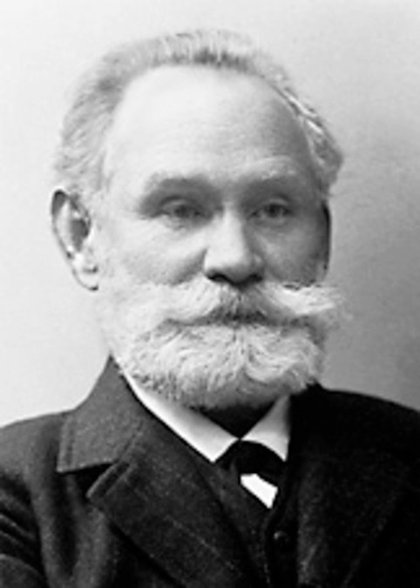
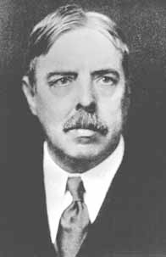
Behavioral Origins of RL
I Pavlov
Classical conditioning associates stimuli (states of the environment) with outcomes
E Thorndike
Instrumental conditioning associates actions with their outcomes

Slide 8
Notes:
经典条件反射

Slide 9
Notes:
操作性条件反射

Slide 10
The typical framing of a Reinforcement Learning (RL) scenario: an agent takes actions in an environment, which is interpreted into a reward and a representation of the state, which are fed back into the agent.

Slide 12
Model-Free and Model-Based Reinforcement Learning
In Model-Free Reinforcement Learning (for example Q-learning), we do not learn a model of the world. We do not explicitly learn transition probabilities or reward functions. We only try to learn the Q-values of actions, or only learn the policy. Essentially, we just learn the mapping from states to actions, maybe modelling how much we're expecting to get in the long run. The algorithm learns directly when to take what action.
In Model-Based Reinforcement Learning, you keep track of the transition probabilities and the reward function. These are typically learned as parametrized models. The models learn what the effect is going to be of taking an particular action in a particular state. This results in an estimated Markov Decision Process which can then be either solved exactly or approximately, depending on the setting and what is feasible.

Slide 13
Assume the task of deciding which route to take on the way home from work on a Friday evening. In model-based computation, you search through a previously learned model (i.e. you have a map and you follow each route based on the model) whereas in model-free computation you simply act based on an experience that suggests avoiding the freeway would typically get you home faster.
Notes:
https://www.quora.com/What-is-the-difference-between-model-based-and-model-free-reinforcement-learning

Slide 15
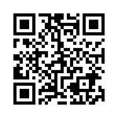
Class feedback

Slide 16
Notes:
https://www.zhihu.com/question/26408259

Slide 21
All of these are assumptions are wrong...

Slide 22
Reinforcement Learning
Markov Decision Problem state transition function - can be learned and is a ‘model’ of the world value function - given a policy describes the expected reward policy - determines actions in states (optionally given a value function)
Solvable with a Bellman Equation (1957)

